Slide 1
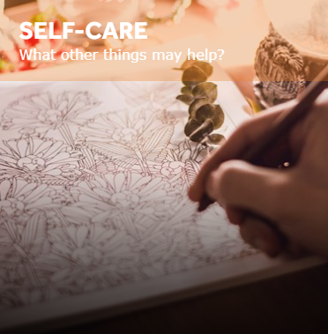
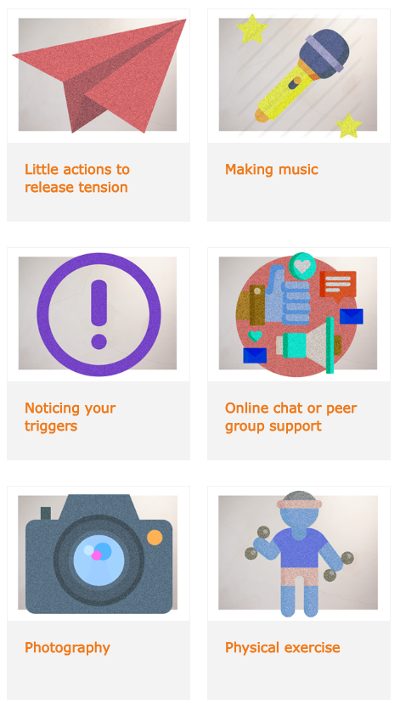
Self-Care
89 self-care strategies to help you manage your wellbeing compiled by other young people.
Visit www.onmymind.info for full list

Slide 2
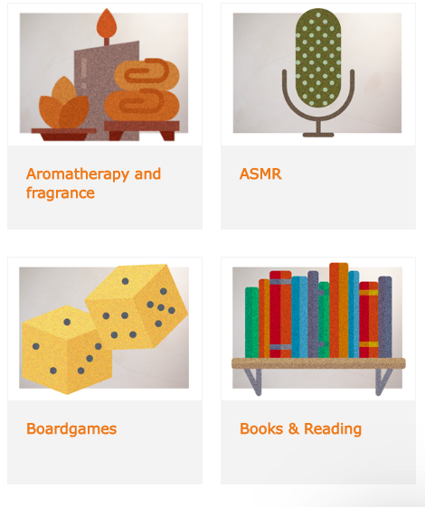
Visit www.onmymind.info for full list

Slide 3
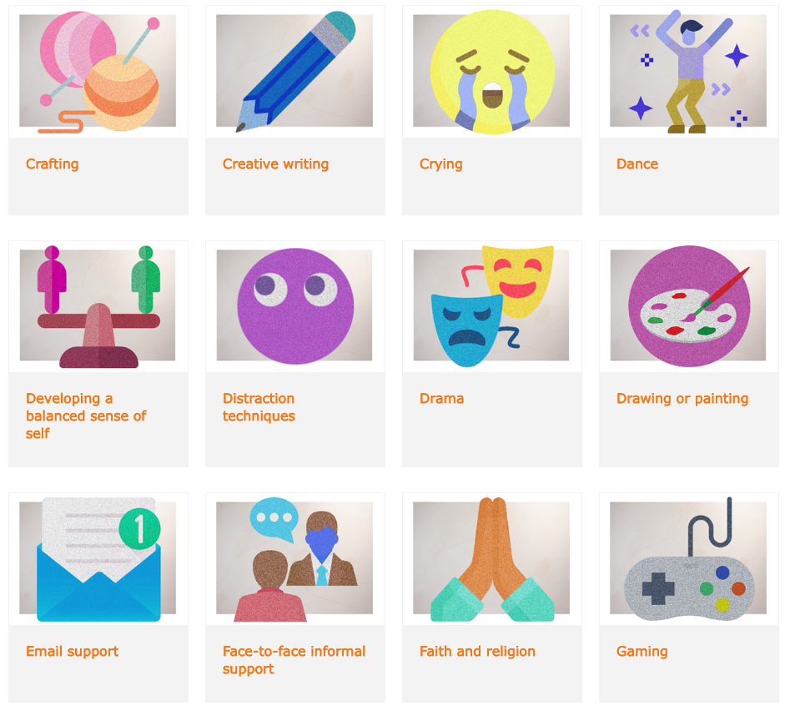
Visit www.onmymind.info for full list

Slide 4
Visit www.onmymind.info

Slide 5
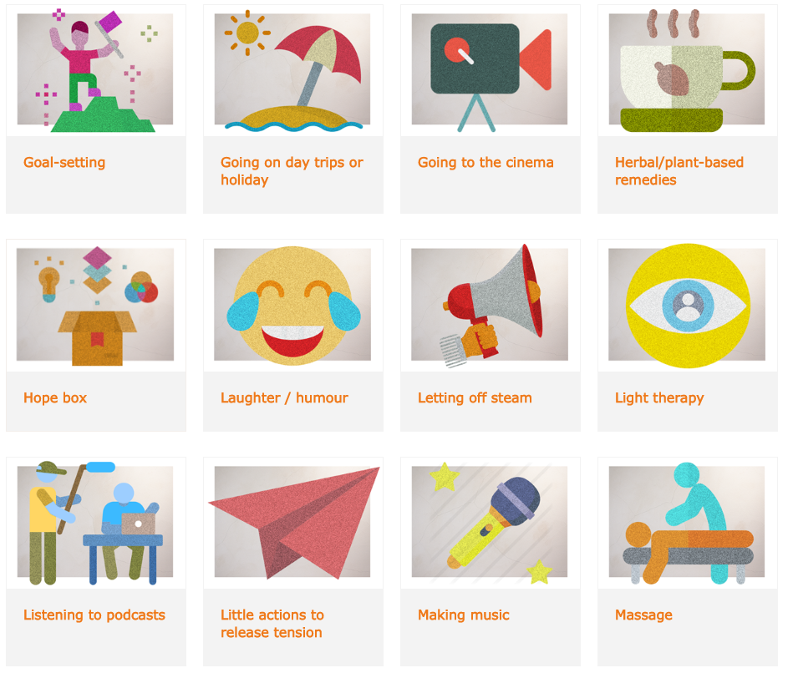
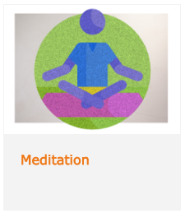
Visit www.onmymind.info for full list

Slide 6
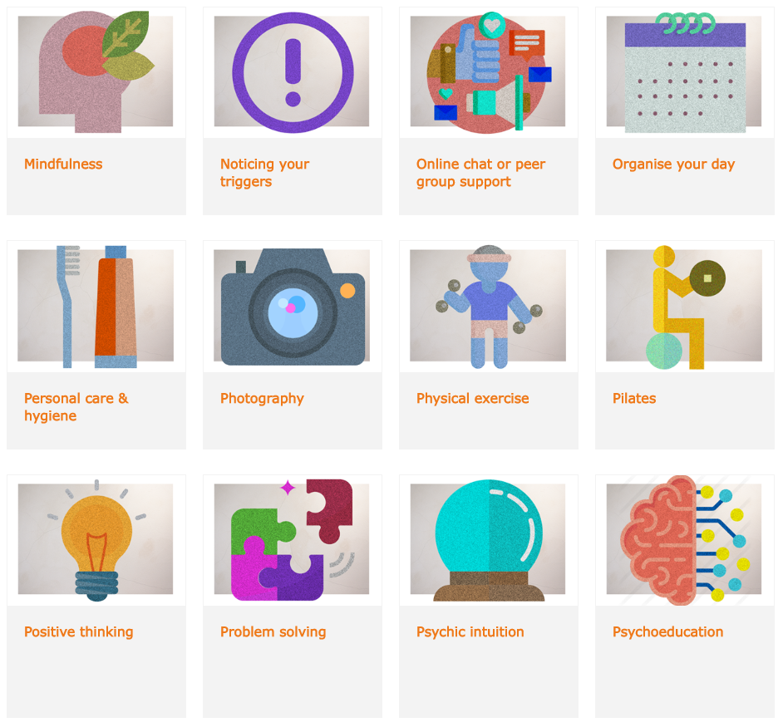
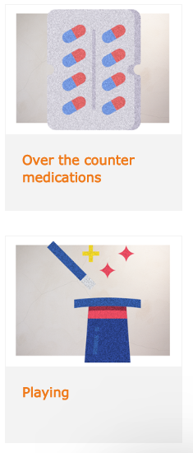
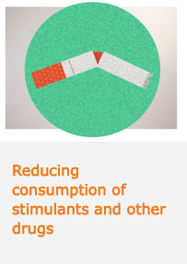
Visit www.onmymind.info for full list

Slide 7
Visit www.onmymind.info

